Slide 1

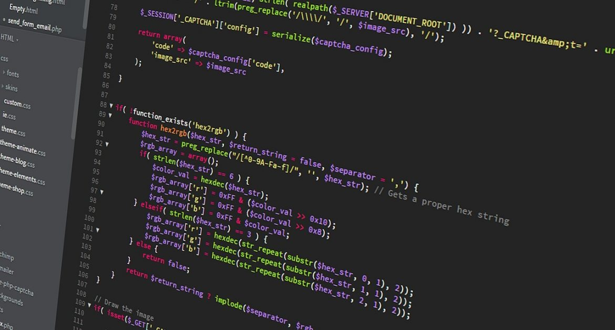
Software Development Concepts
Fundamental Concepts and Paradigms in the Software Engineering Profession
SoftUni Team
Technical Trainers
Software University
https://softuni.bg

Slide 2
Table of Contents
The 4 Skills of the Software Engineers
Fundamental Software Engineering Concepts
Math Concepts in Software Development
Object-Oriented Programming (OOP)
Functional Programming (FP)
Data Structures and Algorithms
Component-Based Development and Event-Driven Programming
Asynchronous Programming and Promises
Software Architectures, Front-End and Back-End
2

Slide 3
Have a Question?
sli.do
#fund-common

Slide 4

The 4 Skills of Software Engineers

Slide 5

Skills of the Software Engineers
4 main groups of technical skills:
Coding skills – 20%
Algorithmic thinking – 30%
Fundamental software development concepts – 25%
Programming languages and software technologies – 25%

Slide 6

Skill #1: Coding (20%)
The skill to write code
Working with commands, IDE, variables, data and calculations, conditional statements, loops
Using functions (or methods) and objects
Working with data structures (arrays, lists, maps and others), libraries and APIs
Courses at SoftUni: softuni.bg/curriculum
Programming Basics, Programming Fundamentals
The programming language doesn't matter!

Slide 7

Skill #2: Algorithmic Thinking (30%)
Algorithmic (engineering, mathematical) thinking
The ability to analyze problems and find solutions
Breaking the problem down to steps (algorithm)
How to develop algorithmic thinking?
Solve 1000+ programming problems
It takes 6 to 12 months of coding every day
Courses in SoftUni: Programming Basics, Fundamentals and Advanced Modules
The programming language doesn't matter!

Slide 8

Skill #3: Fundamental Concepts (25%)
Fundamental software development concepts
Object-oriented programming (OOP)
Functional programming (FP)
Asynchronous programming and parallel execution
Databases: relational DB, SQL, document DB, key-value model
Web technologies: HTTP, JS, DOM, AJAX, REST, …
Software engineering: source control, agile, …
SoftUni Curriculum: Professional Modules
The programming language doesn't matter!

Slide 9

Skill #4: Languages & Technologies (25%)
Programming language and technologies
They only form 25% of the skills of a programmer!
The programming languages and technologies come always together (as a technology stack)!
Example of skills required for a Junior C# / .NET Developer:
C# + .NET Core + Visual Studio + databases + SQL Server + SQL + EF + ASP.NET MVC + HTML + CSS + JS + AJAX + REST + JSON + OOP + FP + algorithmic thinking + Git + software engineering + English + teamwork skills
Software technologies change very fast!
SoftUni Curriculum: Professional Modules

Slide 10

Fundamental Software Engineering Concepts

Slide 11
Math Concepts in Software Development
Basic mathematical concepts related to programming
Coordinate systems (used in computer graphics)
Mathematical functions (lambda calculus, discrete functions, …)
Vectors and matrices (used in graphics, machine learning, …)
Finite state automata and state machines (used in parsers)
Statistics concepts (used in machine learning)
Algorithm complexity (estimate the speed)
Mathematical modeling

Slide 12
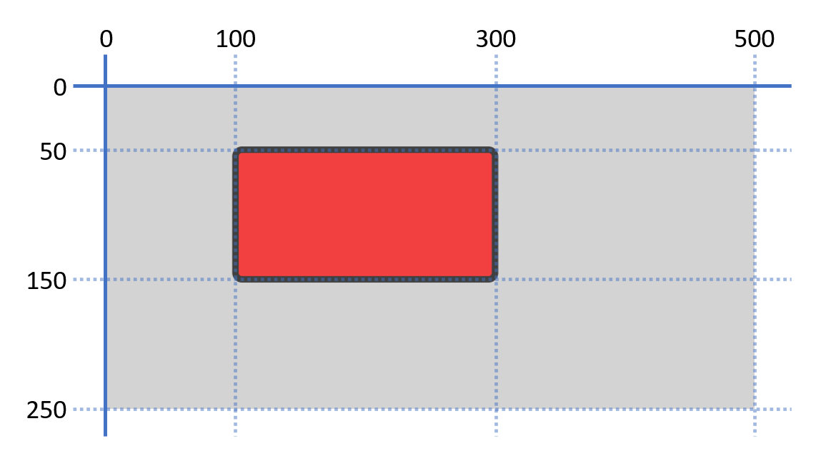
Coordinate System and SVG – Example
<svg width="500" height="250" style="background:lightgray">
<rect x="100" y="50" width="200" height="100" rx="5" ry="5" style="fill:red;stroke:black;stroke-width:5;opacity:0.7" />
</svg>

Slide 13
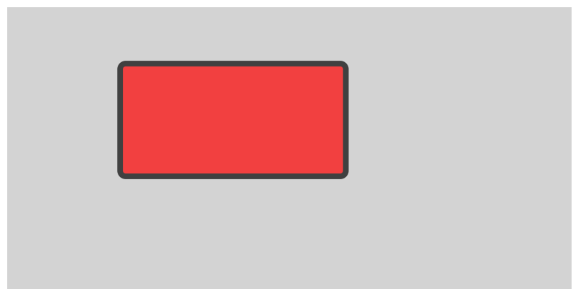
SVG and the Coordinate System
Live Demo
https://repl.it/@nakov/SVG-example

Slide 14
Object-Oriented Programming (OOP)
Object-Oriented Programming (OOP) is the concept of using classes and objects (class instances) to model the real world
Class definition
class Rectangle {
int width, height;
int CalcArea() { return width * height;
}
}
width = 5
height = 6
width = 6
height = 4
Fields (data)
Methods (actions)
width = 7
height = 3
Objects

Slide 15

Object-Oriented Programming (OOP)
Live Demo
https://repl.it/@nakov/rectangle-oop-js
https://repl.it/@nakov/rectangle-oop-cs

Slide 16

Inheritance and Interfaces
Inheritance allows classes to inherit data and functionality from a parent class (base class)
Interface – defines abstract actions
Actions to be implemented in descendent classes
Abstract class – abstraction, e.g. Figure
Defines data + actions + abstract actions
Concrete class – e.g. Circle, Rectangle
Defines data + concrete functionality

Slide 17
Inheritance and Interfaces – Example
Base abstract class
abstract class Figure {
int x, y;
abstract int calcArea();
}
Abstract method
Child class
class Circle extends Figure {
int radius;
override int calcArea() =>
PI * radius * radius;
}
class Rectangle extends Figure {
int width, height;
override int calcArea() =>
width * height;
}

Slide 18

Inheritance in OOP
Live Demo
https://repl.it/@nakov/inheritance-oop-js
https://repl.it/@nakov/inheritance-oop-cs

Slide 19
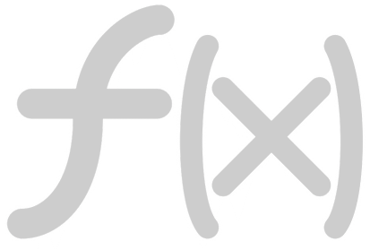
Functional Programming
Functional programming (FP)
Programming by composing pure functions, avoiding shared state, mutable data, and side-effects
Declarative programing approach (not imperative)
Program state flows through pure functions
Pure function == function which returns value only determined by its input, without side effects
Examples: sqrt(x), sort(list) → sorted list
Pure function == consistent result

Slide 20
Functional Programming Languages
Purely functional languages are unpractical and rarely used
The program is pure function without side effects, e.g. Haskell
Impure functional languages
Emphasize functional style, but allow side effects, e.g. Clojure
Multi-paradigm languages
Combine multiple programing paradigms: functional, structured, object-oriented, …
Examples: JavaScript, C#, Python, Java

Slide 21
Functional Programming – Examples
Read several numbers and find the biggest of them (in C#)
Functional style
Imperative style
Console.WriteLine(
Console.ReadLine()
.Split(" ")
.Select(int.Parse)
.Max()
);
var input = Console.ReadLine();
var items = input.Split(" ");
var nums = items.Select(int.Parse);
var maxNum = nums.Max();
Console.WriteLine(maxNum);

Slide 22
Functional Programming (FP)
Live Demo
https://repl.it/@nakov/functional-max-num-cs
https://repl.it/@nakov/imperative-max-num-cs

Slide 23
Lambda and First-Class Functions
Lambda functions: anonymous function (formula)
JS, Python, C# and Java and support first-class functions (functions can be stored in variables and passed as arguments)
x => 2 * x
C#
x => 2 * x
JS
lambda x: 2 * x
Python
JS
Python
let twice = x => 2 * x;
let d = twice(5); // 10
twice = lambda x: 2 * x
d = twice(5) # 10
Func<int, int> twice =
x => 2 * x;
var d = twice(5); // 10
C#
Function<Integer, Integer>
twice = x -> 2 * x;
var d = twice.apply(5);
Java

Slide 24
First-Class Functions
Live Demo
https://repl.it/@nakov/first-class-function-js

Slide 25
Higher Order Functions – Examples
Higher-order functions take other functions as arguments
function aggregate(start, end, func) {
for (var result = start, i = start + 1; i <= end; i++)
result = func(result, i);
return result;
}
aggregate(1, 10, (a, b) => a + b) // 55
aggregate(1, 10, (a, b) => a * b) // 3628800
aggregate(1, 10, (a, b) => '' + a + b) // "12345678910"

Slide 26
Higher-Order Functions
Live Demo
https://repl.it/@nakov/higher-order-functions-js

Slide 27
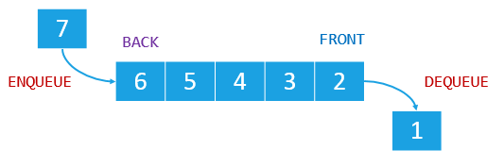
Data Structures
Data structures are representations of data in the computer memory, which allow efficient access and modification
Linear data types: arrays, lists, stacks, queues
0
1
2
3
4
…
…
…
…
…
Array / list (indexed group of elements)
Linked list (sequence of linked elements)
Queue

Slide 28
List of Numbers – Example
List of numbers, representing a sequence of income amounts:
Adding a new income:
Modifying an existing income:
var incomes = [
150, 200, 70.50, 120
];
Element | Value
incomes[0] | 150
incomes[1] | 200
incomes[2] | 70.50
incomes[3] | 120
250
incomes.push(300);
incomes[4] | 300
incomes[1] = 250;
28

Slide 29
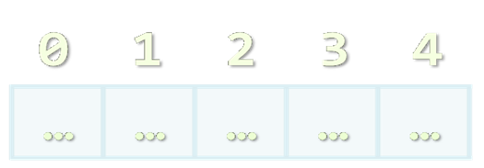
List of Numbers
Live Demo
https://repl.it/@nakov/list-example-js

Slide 30
Data Structures and Algorithms
Trees and tree-like data structures
Each node holds data + list of child nodes + parent node
Tree traversal algorithms
Depth-First Search (DFS)
Breadth-First Search (BFS)
C:\
DepthFirstSearch(node) {
print(node);
for each ch in node.childNodes
DepthFirstSearch(ch)
}
Programs
Users
Windows
Maria
Peter
George

Slide 31
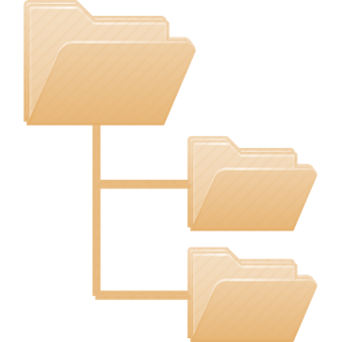
Recursive Traversal of the File System
Live Demo
https://repl.it/@nakov/traverse-folders-cs

Slide 32

Component-Based Software Development
Component-based software development
A programming paradigm in which applications are composed of re-usable components
Components are self-contained pieces of functionality
E.g. PDF generator, email sender, date picker UI control
User interface (UI) components are also known as UI controls, visual components or widgets
Components are distributed in libraries
E.g. the UI control library jQuery UI

Slide 33
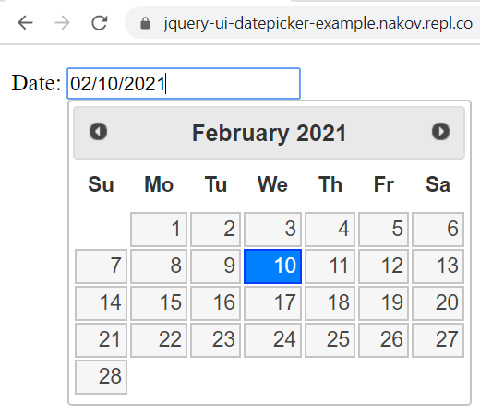
Example of Software Component
UI component "date picker"

Slide 34
jQuery UI Date Picker – Example
<script src="https://code.jquery.com/jquery-1.12.4.js"></script>
<script src="https://code.jquery.com/ui/1.12.1/jquery-ui.js"></script>
<link rel="stylesheet" href="https://code.jquery.com/ui/1.12.1/themes/base/jquery-ui.css">
Date: <input type="text" id="datepicker">
<script>
$(() => $("#datepicker").datepicker());
</script>

Slide 35
jQuery UI Date Picker
Live Demo
https://repl.it/@nakov/jquery-ui-datepicker-example

Slide 36
Event-Driven Programming
Event-driven programming
A programming paradigm in which the flow of the program is determined by events, e.g. mouse clicks, key presses, etc.
Event source (event emitter)
Produces events, e.g. when the mouse is clicked
Event handler (event consumer, callback)
Processes events, e.g. show a message

Slide 37
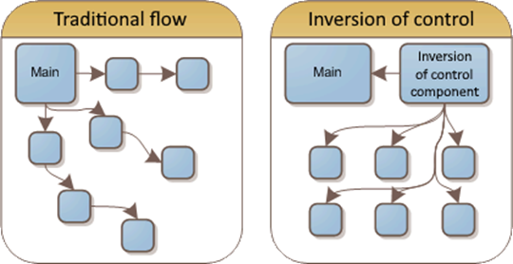
Inversion of Control (IoC)
Inversion of control (IoC) principle
A function / component / framework does the processing and calls pieces of your code for certain tasks
Examples of IoC behavior:
A parser processes a document and calls events when it finds certain tokens
A GUI app manages the UI and calls events for the user input

Slide 38
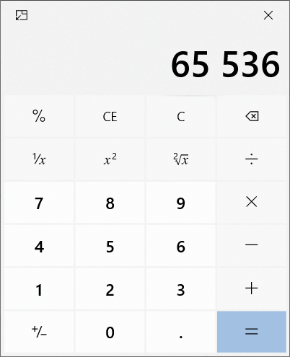
Example of IoC and Event-Driven Programming
The UI framework draws the UI and check for events in a loop (event loop)
Clicking a button emits an event, which is handled by the calculator's engine

Slide 39
Event-Driven Programming – Example
function analyzeString(text, onLetter, onNewWord) {
let newWord = true;
for (const letter of text) {
if (letter.match(/\w/i)) {
if (newWord)
onNewWord();
onLetter(letter);
newWord = false;
} else
newWord = true;
}
}
Scan through the text, extract letters and detect where a new word starts
Emit an event
Event-driven processing with inversion of control
Emit an event

Slide 40
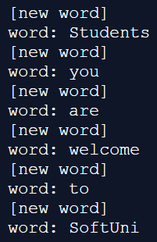
Event-Driven Programming – Example (2)
Execute an inversion of control processing
let word = '';
analyzeString(
"Students, you are welcome to SoftUni!",
function onLetter(l) { word += l },
function onNewWord(l) {
if (word != '')
console.log('word:', word);
console.log('[new word]');
word = '';
}
);
console.log('word:', word);
Event handler
Event handler

Slide 41
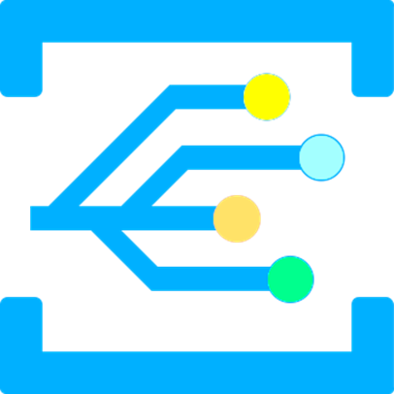
Event-Driven Programming
Live Demo
https://repl.it/@nakov/event-driven-example-js

Slide 42
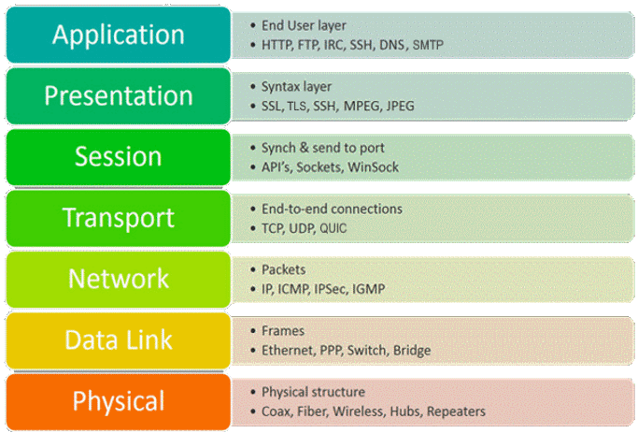
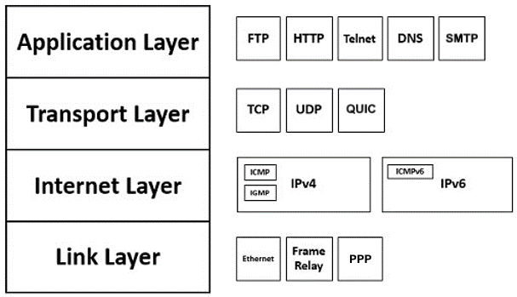
Networking and Internet Protocols
Communication in Internet uses networking protocols
The OSI model defines 7 layers of networking protocols
The TCP/IP protocol suite

Slide 43

HTTP and Socket Communication
Most applications communicate through HTTP or sockets
HTTP is "request / response" based protocol for the Web
Clients request resources (GET / POST / PUT / DELETE request)
The Web server provides the resource (HTTP response)
Sockets are bidirectional communication streams
Web sockets are sockets that run over HTTP
Allow JavaScript client to communicate with the Web server bidirectionally

Slide 44
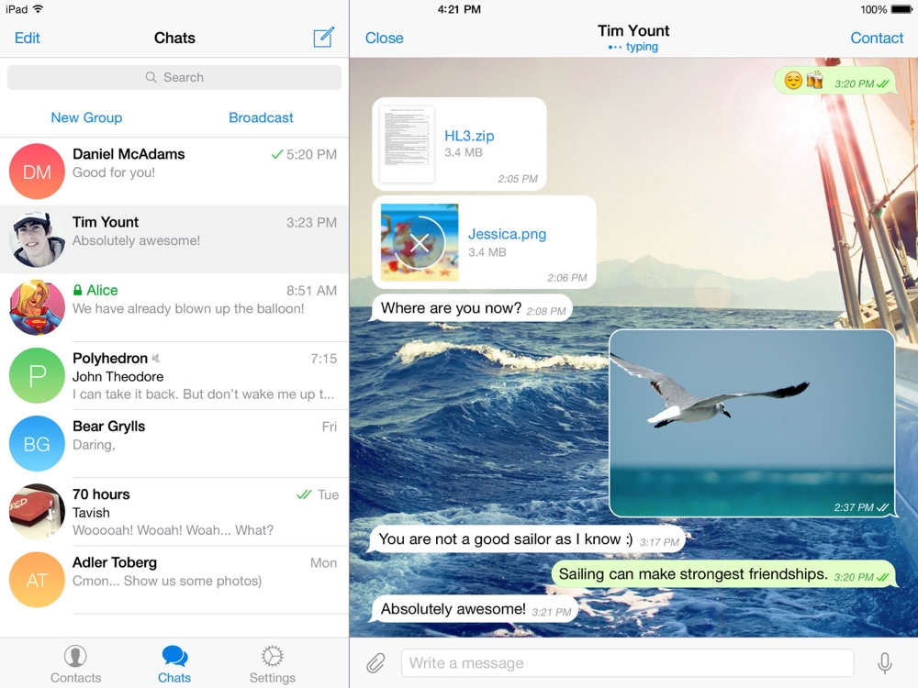
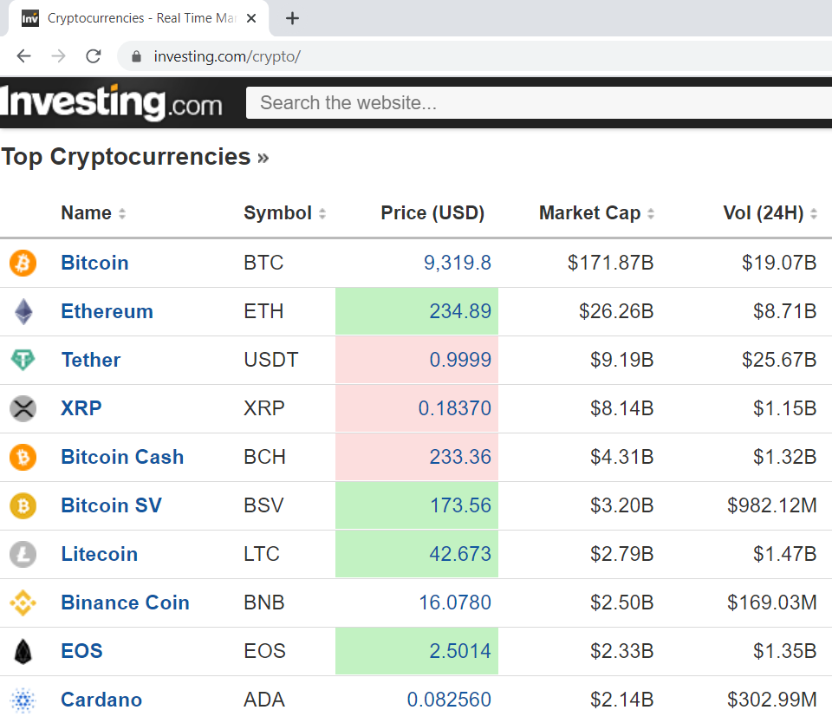
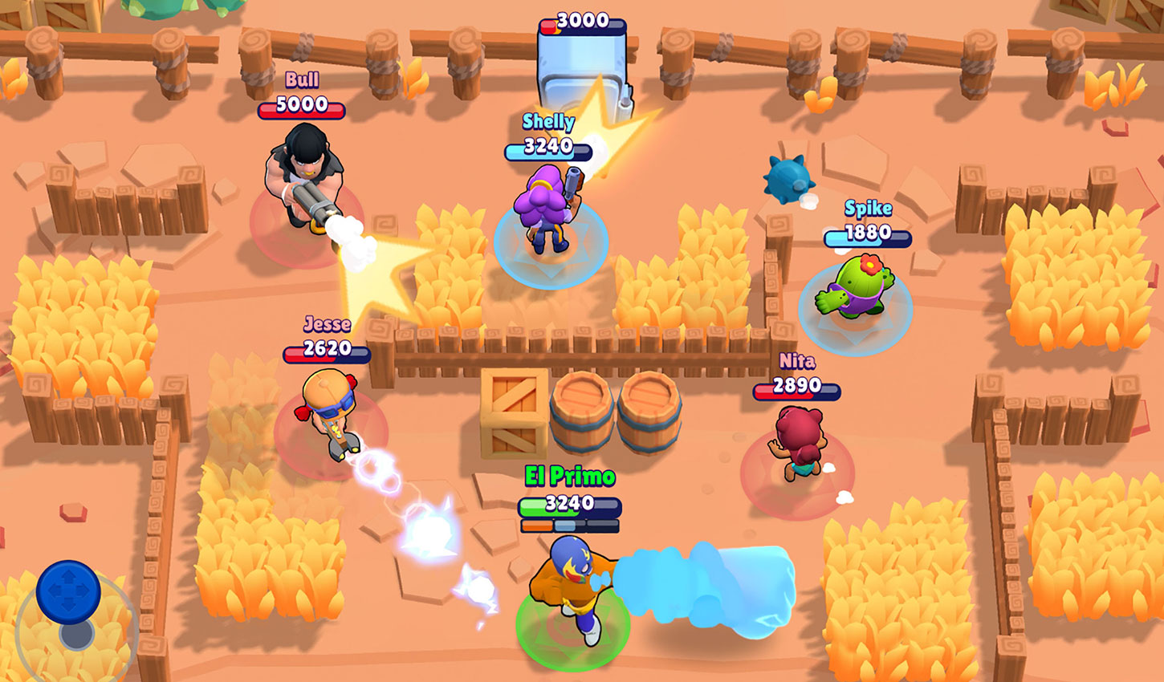
Real-World Example of Socket Communication
Telegram Messenger
The "Brawl Stars" Game
The Live Crypto Prices Dashboard @ Investing.com

Slide 45
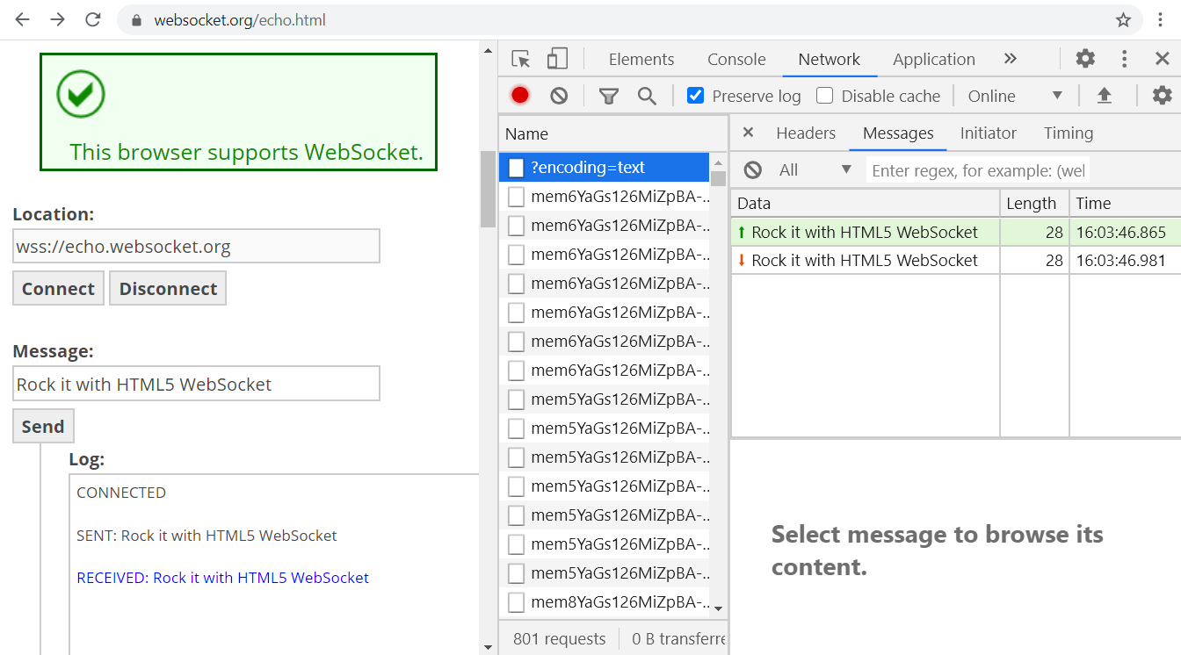
Example of Web Socket Communication

Slide 46
The WebSocket API in HTML5: Server
The WebSocket API provides bidirectional socket communication for Web apps, part of the HTML5 standard
Sample code, implementing a WebSocket server:
const WebSocket = require('ws');
const wsServer = new WebSocket.Server({ port: 8080 });
wsServer.on('connection', function(ws) {
ws.on('message', function(msg) {
ws.send('You said: ' + msg);
});
ws.send('WSS Echo Server: Welcome!');
});

Slide 47
The WebSocket API in HTML5: Client
Sample code, implementing a WebSocket client:
let ws = new WebSocket("wss://websocket-server-js.nakov.repl.co");
ws.onopen = e => {
document.write("<p>Connected.</p>");
ws.send("Hello");
}
ws.onmessage = e =>
document.write("<p>Received: <i>" + e.data + "</i></p>");
ws.onclose = e => document.write("<p>Disconnected.</p>");
ws.onerror = e => document.write("<p>Error: " + e + "</p>");

Slide 48
WebSocket
Live Demo
https://www.websocket.org/echo.html
https://repl.it/@nakov/websocket-server-js
https://repl.it/@nakov/websocket-client-js

Slide 49
Asynchronous Programming
Asynchronous programming and concurrent execution allow multiple pieces of code to run simultaneously
Multithreading in Java and C# (several threads run concurrently)
Accessing common data from concurrent threads may need synchronization (mutexes, semaphores, atomic operations)
Background tasks (C#) and promises (JS) with async / await
Web Workers and Service Workers in HTML5
Multiple parallel processes in Windows / Linux

Slide 50
Web Worker – Example
web-worker-example.html
worker.js
<!DOCTYPE html>
<html>
<script>
let w1 = new Worker('worker.js');
w1.onmessage = e => document.write(
"<p>Worker #1 received: <i>" +
e.data + "</i></p>");
let w2 = new Worker('worker.js');
w2.onmessage = e => document.write(
"<p>Worker #2 received: <i>" +
e.data + "</i></p>");
</script>
</html>
let counter = 0;
setInterval(() => {
postMessage(++counter);
}, 1000);

Slide 51

Concurrent Execution using Web Workers
Live Demo
https://repl.it/@nakov/webworker-js

Slide 52
Promises
A promise in JS holds an operation that runs asynchronously
After completion or failure an event is called
let request = fetch('https://blog.softuni.org/wp-json/wp/v2/posts');
request.then(function(response) {
response.json().then(function(posts) {
console.log(JSON.stringify(posts));
});
});
request.catch((err) => console.log(err));

Slide 53

Fetching Resources Asynchronously
Live Demo
https://repl.it/@nakov/fetch-example-js

Slide 54
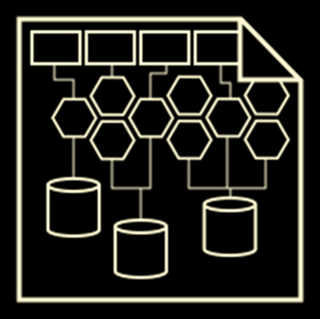
Software Architectures

Slide 55
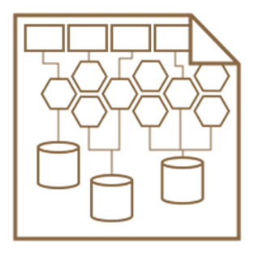
Software Architectures
Software systems consist of interconnected components organized in certain structure called architecture
Concepts related to software architectures:
Monolith apps
Client-server model
Front-end and back-end
3-tier and multi-tier architecture
SOA and microservices

Slide 56
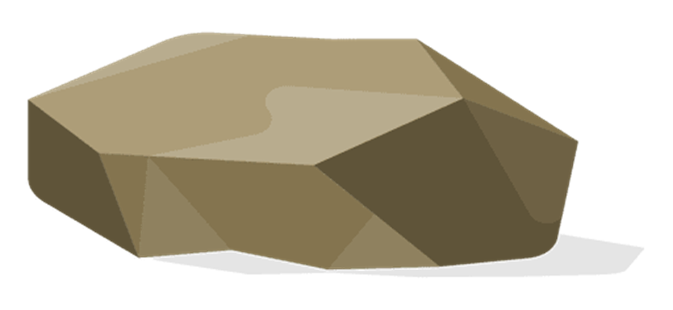
Monolith Apps
Monolith apps
A single application holds its data, logic and user interface (UI)
Single user (no shared data access)
Disconnected from Internet
App data is stored on the local machine
Examples:
A simple smartphone game
The Notepad text editor

Slide 57

The "Client-Server" Model
The client-server architectural model
The server holds app data and logic and provides APIs to clients
The clients implement the UI (the user interface) and consume the server APIs
Examples:
Web browser ↔ Web site
Email client ↔ Email server
Chat client ↔ Chat server

Slide 58







3-Tier Architecture / Multi Tier Architecture
Presentation tier
Business logic tier
Data management tier
Client (Web browser)
Web application server (e.g. JBoss)
Database server (e.g. MySQL)
Client (mobile app)

Slide 59
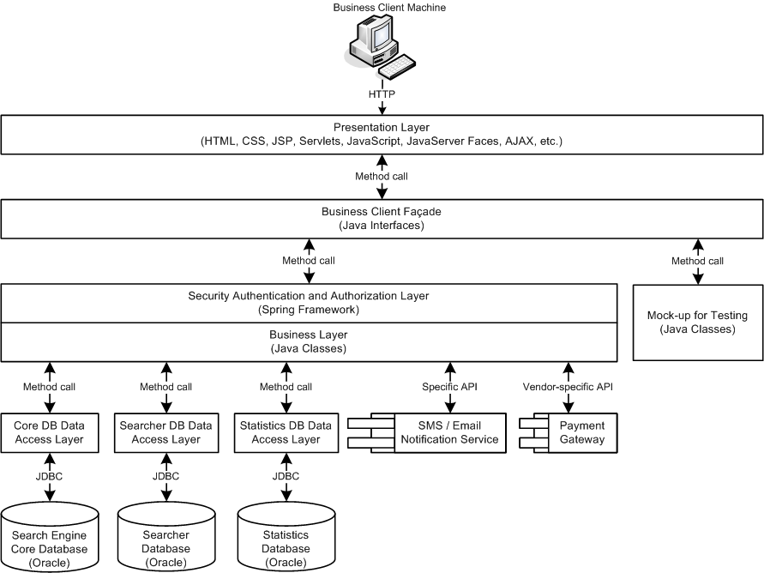
Software Architecture – Example

Slide 60
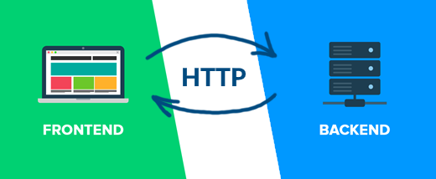
Front-End and Back-End
Front-end and back-end separate the modern apps into client-side (UI) and server-side (data) components
Front-end == client-side components (presentation layer)
Implement the user interface (UI)
Back-end == server-side components (data and business logic APIs)
Implements data storage and processing
HTTP connects front-end with back-end

Slide 61

Front-End Technologies
Front-end technologies
Web front-end: HTML + CSS + JavaScript + JS libraries
Web front-end frameworks: React, Angular, Vue, Flutter
Desktop front-end: XAML (Microsoft), UIKit (Apple)
Mobile front-end: Android UI, SwiftUI
Hybrid mobile front-end: React Native, Ionic
Front-end developers deal with UI, UX and front-end technologies and frameworks

Slide 62

Back-End Technologies
Back-end technologies: server-side frameworks and libraries
C# / .NET back-end: ASP.NET MVC, Web API, Entity Framework, …
Java back-end: Java EE, Spring MVC, Spring Data, Hibernate, …
JavaScript back-end: Node.js, Express.js / Meteor, MongoDB, …
Python back-end: Django / Flask, Django ORM / SQLAlchemy, …
PHP back-end: Apache, Laravel / Symfony, …
Back-end developers deal with the business logic, data processing, data storage, APIs

Slide 63
Full Stack Development
Full stack development
Combines back end + front-end
Requires end-to-end architecture, design and implementation
Full stack developers
Build back-end services: business logic, data processing, data storage, databases, server-side APIs, containers and cloud
Build front-end apps: Web, mobile and desktop UI
Connect and integrate the front-end with the back-end

Slide 64

Summary
…
…
…
The 4 skills of the software engineers:
Coding
Problem Solving
Development Concepts
Software Technologies
OOP, FP, Async, Event-Driven Programming
Software Architectures
Front-End and Back-End
64

Slide 65
Questions?
Notes:
65

Slide 66
Trainings @ Software University (SoftUni)
Software University – High-Quality Education, Profession and Job for Software Developers
softuni.bg, softuni.org
Software University Foundation
softuni.foundation
Software University @ Facebook
facebook.com/SoftwareUniversity
Software University Forums
forum.softuni.bg
Notes:
66

Slide 67

License
This course (slides, examples, demos, exercises, homework, documents, videos and other assets) is copyrighted content
Unauthorized copy, reproduction or use is illegal
© SoftUni – https://softuni.org
© Software University – https://softuni.bg
Notes:
67

